Slide 1
GPT-3 Pre-Teaching Primer
By Team #17 Deep Learning Labs
Peter Halasz, Alif Jakir, Marcin Czernicki, Nabeel Raza

Slide 2
Who We Are
Peter Halasz - C# and Unity3D Developer, lexicographer
Alif Jakir - Clarkson University Sophomore, CS+Data Science & Robotics, new to AI, some programming experience
Marcin Czernicki - electrical engineer, Junior Data Scientist, new to AI, ML enthusiast
Nabeel Raza - MS in Data Science

Slide 3
Problem Statement
How can we help people learning topics to better understand the topic quicker?

Slide 4
Where does GPT-3 Come In?
GPT-3 Automatically picks a difficult concept to explain from a web page, such as through the prompt “What concepts in this page would be difficult for an english learner?

Slide 5
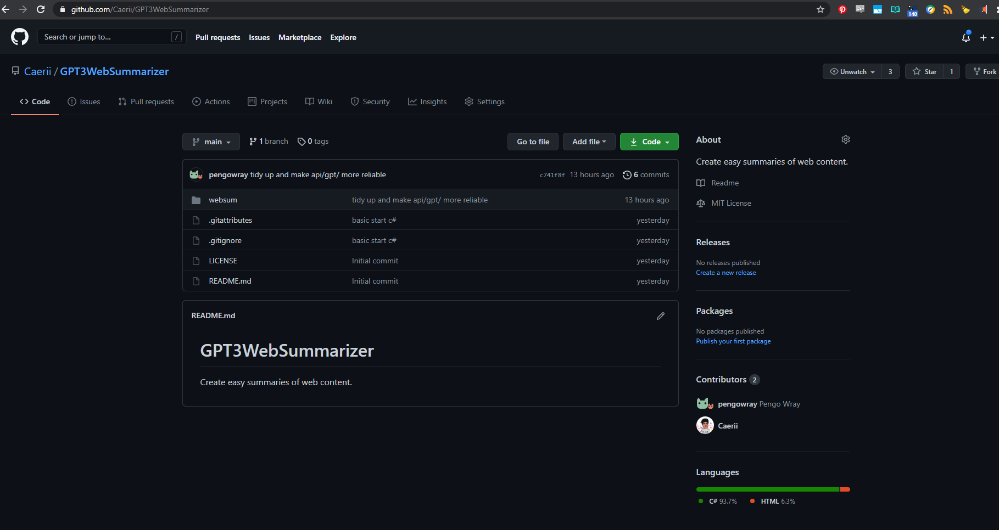

Slide 6
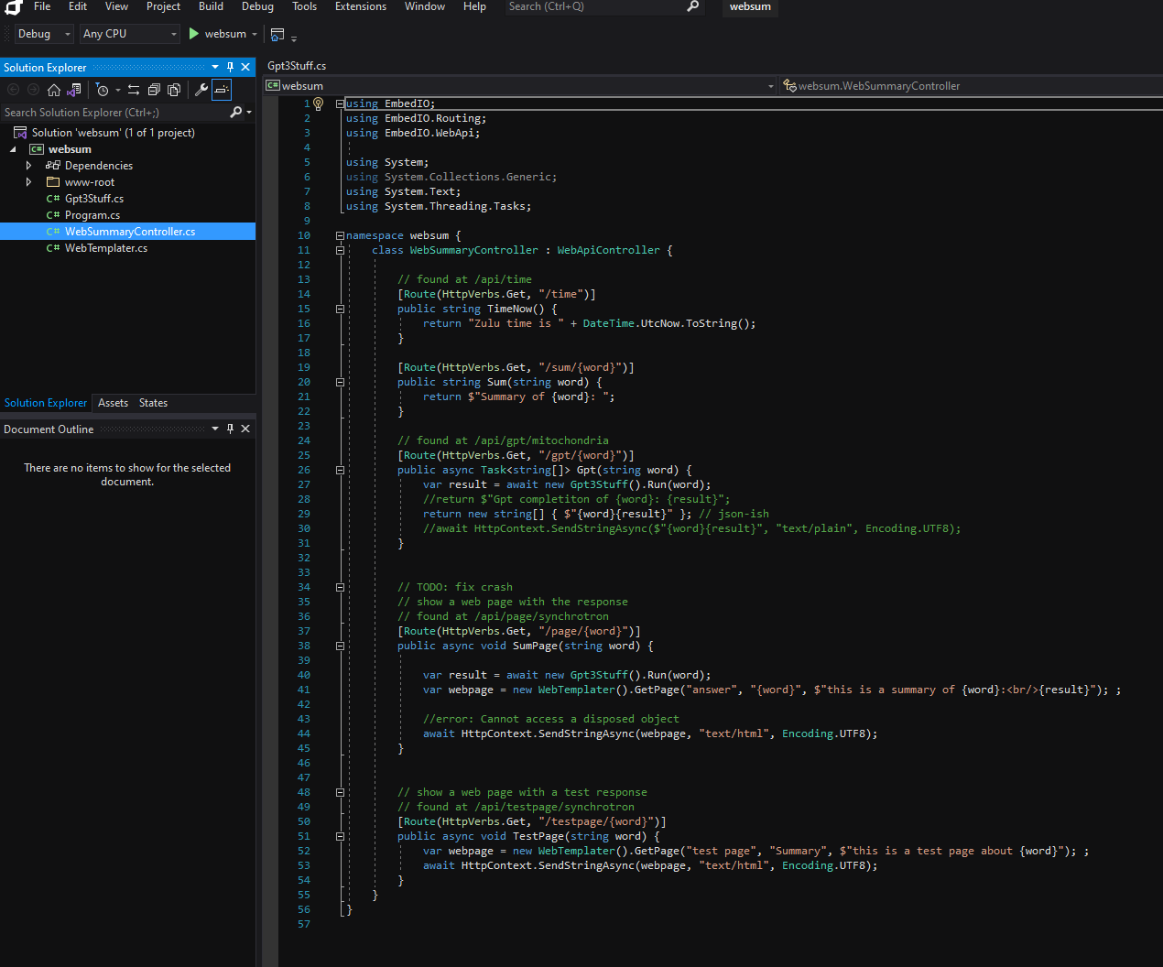

Slide 7
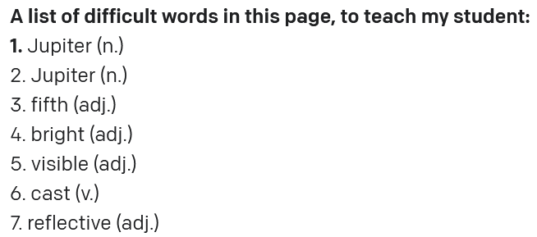
Identifying Difficult Words from a page.

Slide 8
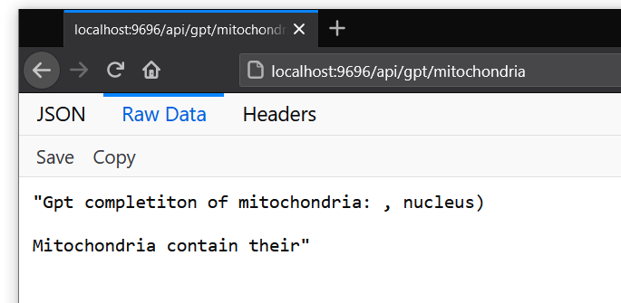
GPT-3 Providing incomplete sentences with the answer for getting questions from pages on the topic of Biology

Slide 9
Unfinished (Further thoughts)
For further progress on this, we would add the option to input entire documents, for extraction of large amounts of teaching material, as well as scraping of web pages.
There was however, not enough time to finish the project.

